Slide 1




Measurement Incompatibility and Semi-quantum
Nonlocal Games
Eric Chitambar
University of Illinois at Urabana-Champaign
MAQIT 2019, National University of Seoul
May 23, 2019
Wenbin Zhou
Francesco Buscemi
Joint work with:

Slide 2




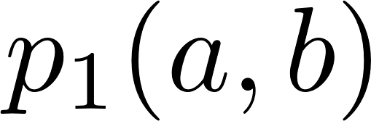


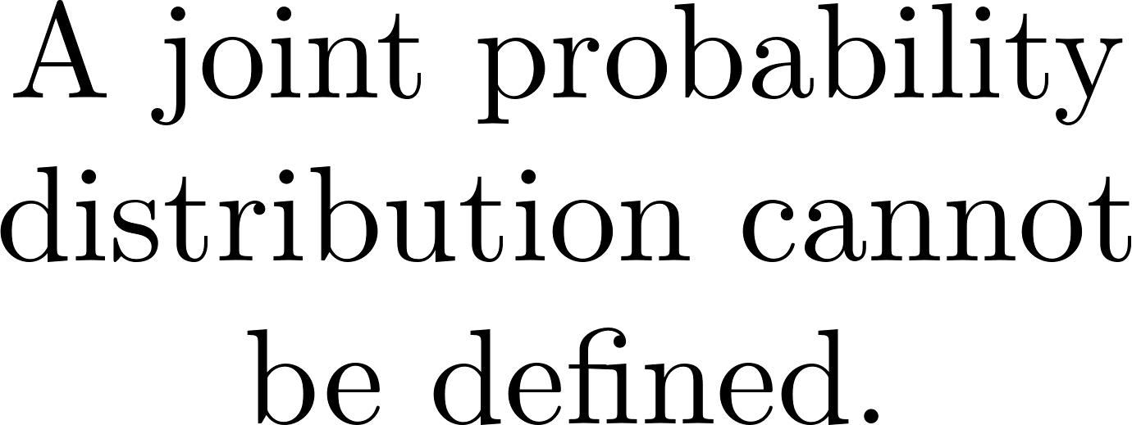
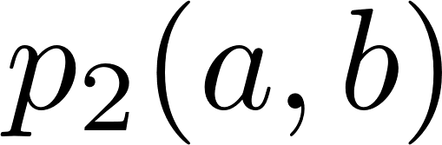
Measurement Incompatibility based on Sequential Measurement

Slide 3
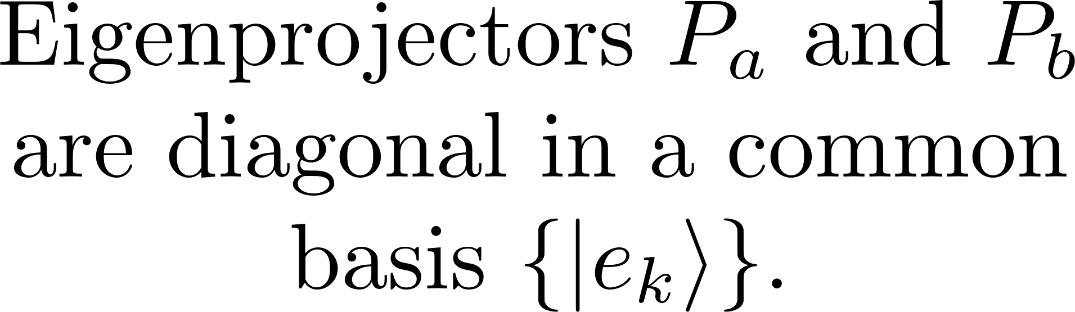
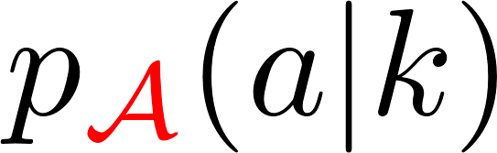


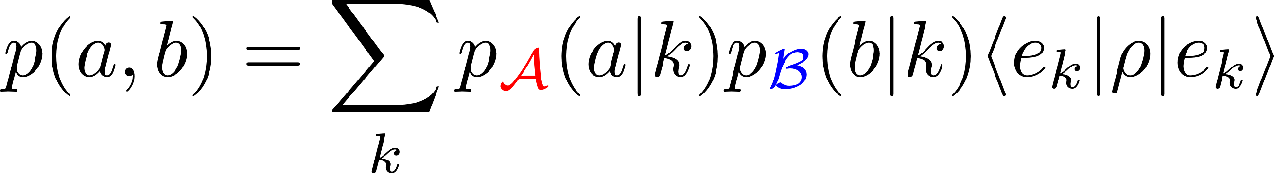
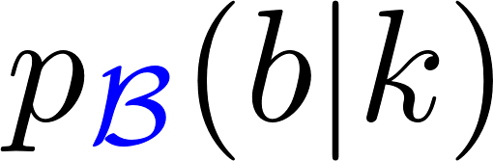
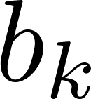
Measurement Incompatibility in Observables

Slide 4

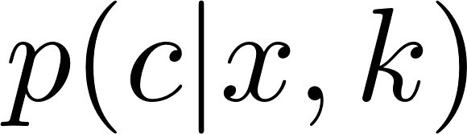

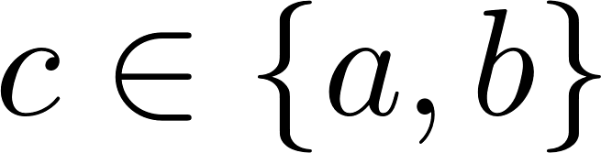
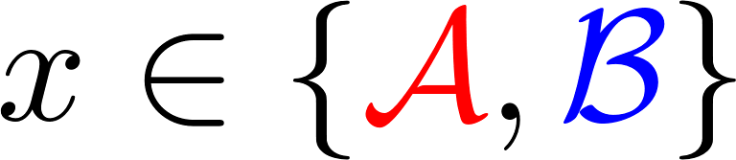

Measurement Incompatibility in Observables

Slide 5

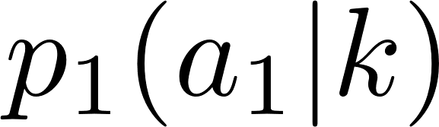

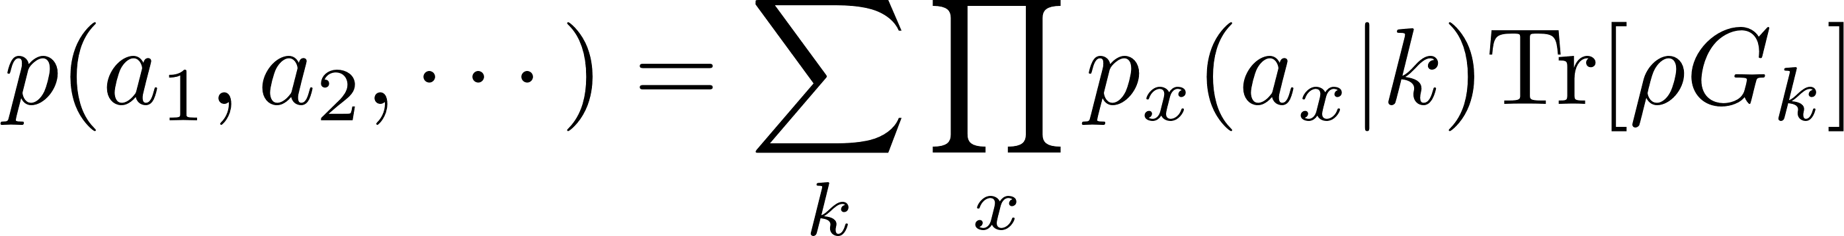
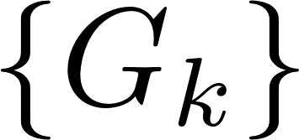
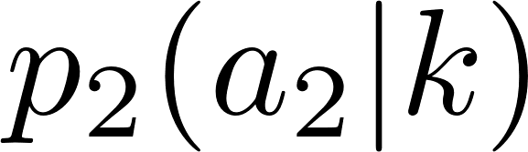

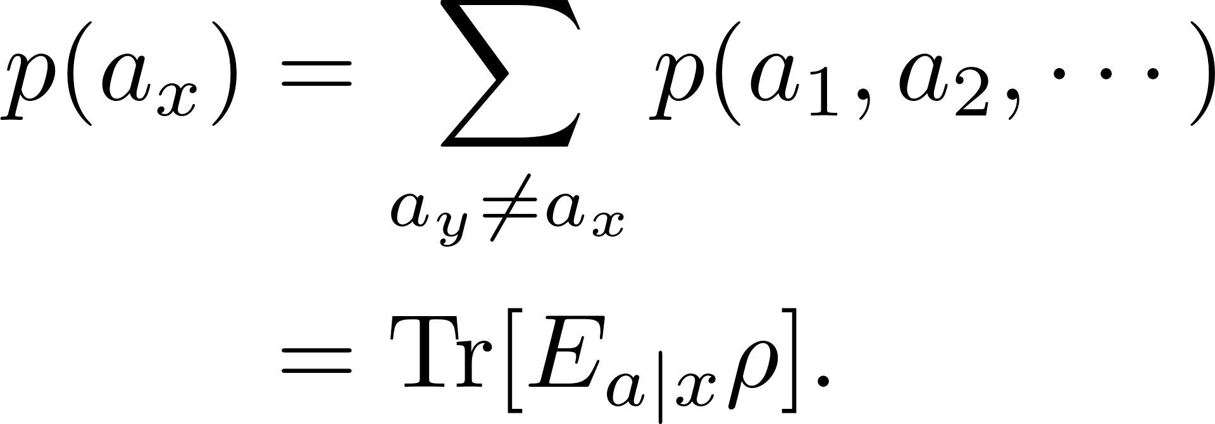
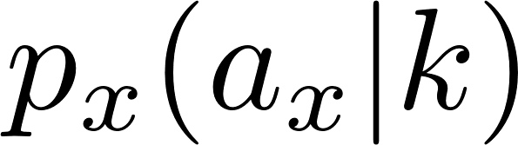

Measurement Incompatibility in POVMs

Slide 6
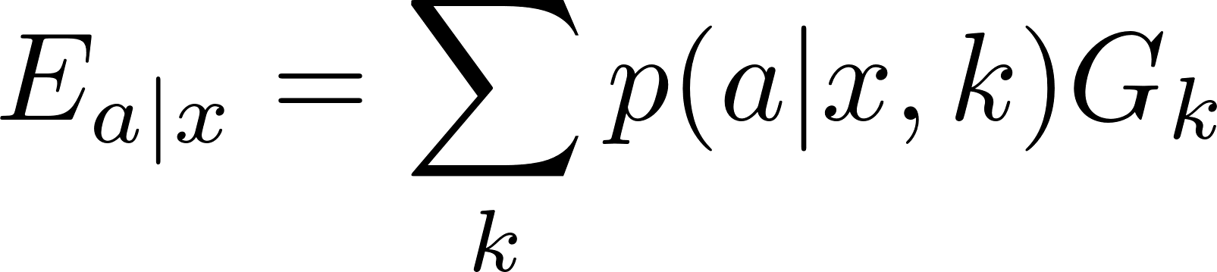
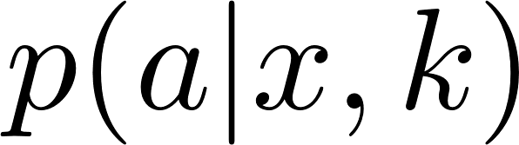


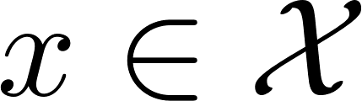
Measurement Incompatibility in POVMs

Slide 7



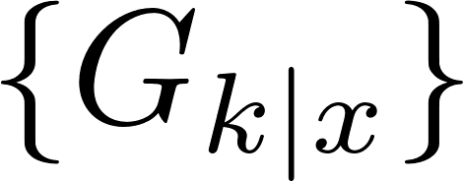
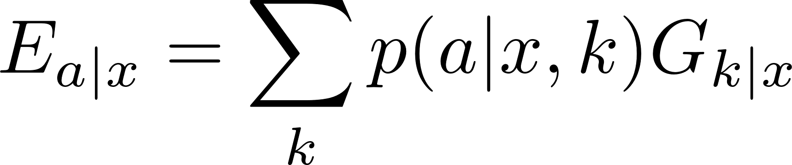
Measurement Incompatibility in POVMs

Slide 8

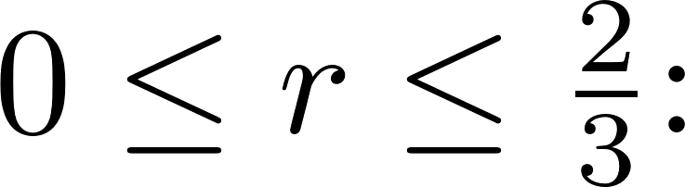
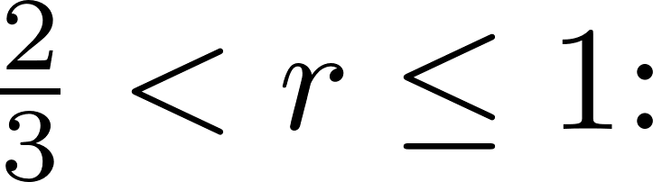

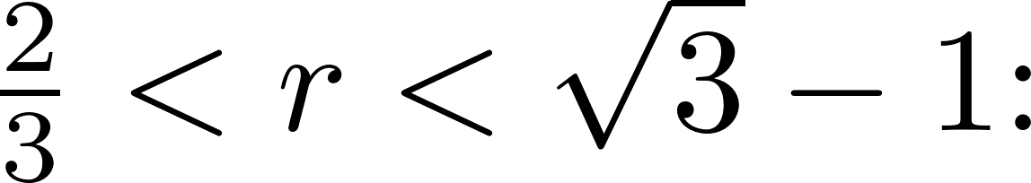


Qubit Example of Measurement Incompatibility

Slide 9
Is Measurement Incompatibility Related to any other Fundamental Quantum Phenomena?

Slide 10




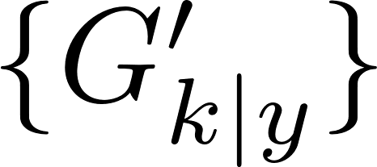


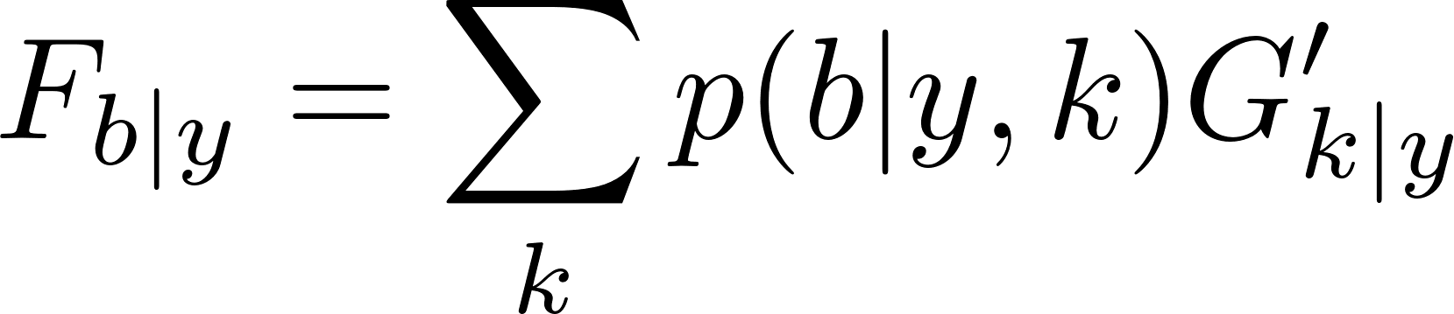
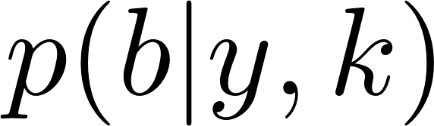

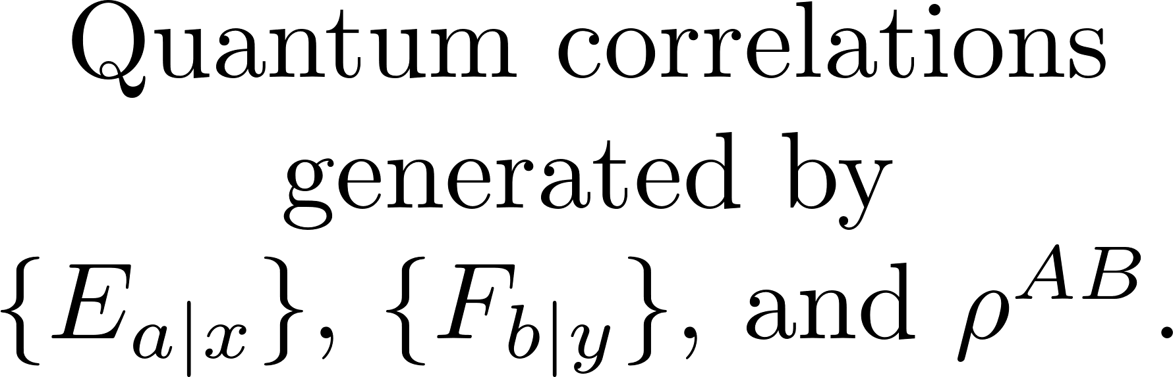
Measurement Incompatibility and Bell Nonlocality

Slide 11
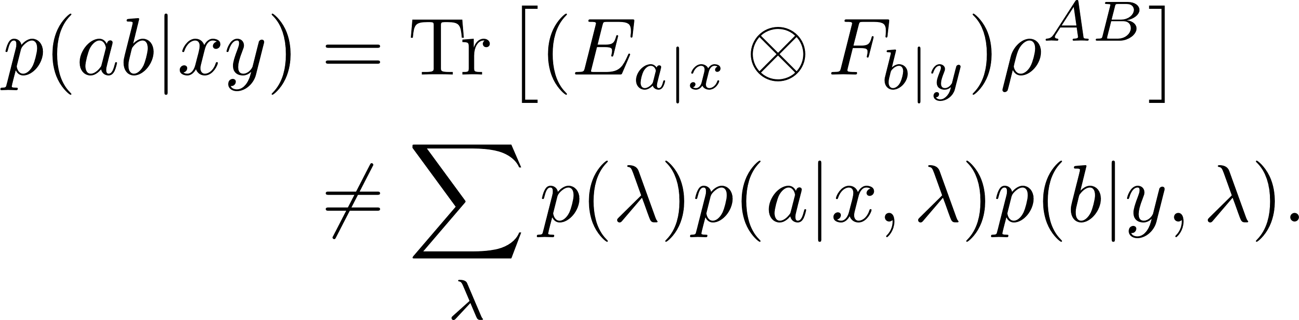
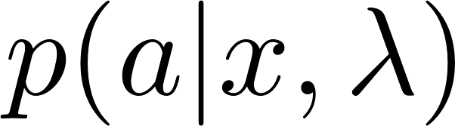


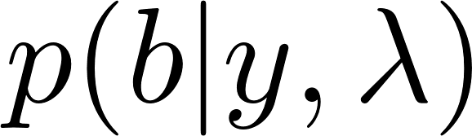
Measurement Incompatibility and Bell Nonlocality

Slide 12
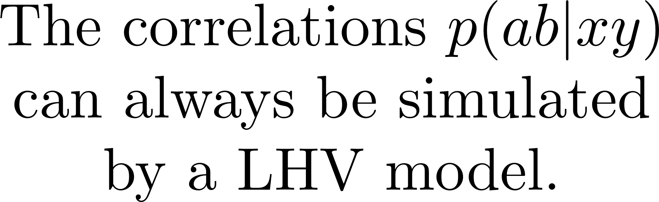
Measurement Incompatibility and Bell Nonlocality

Slide 13


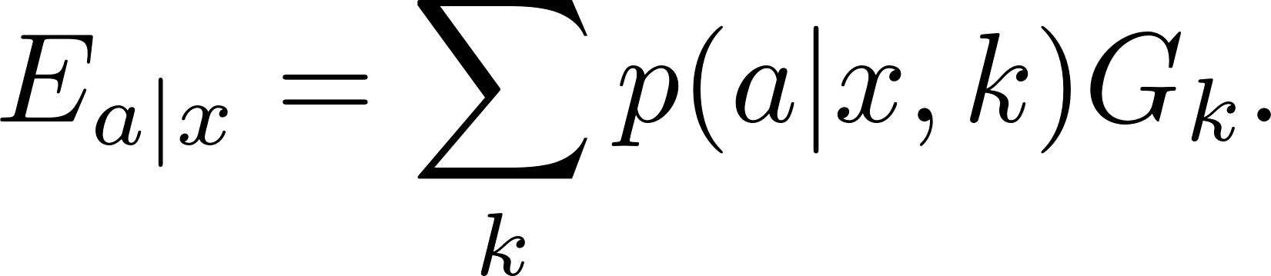

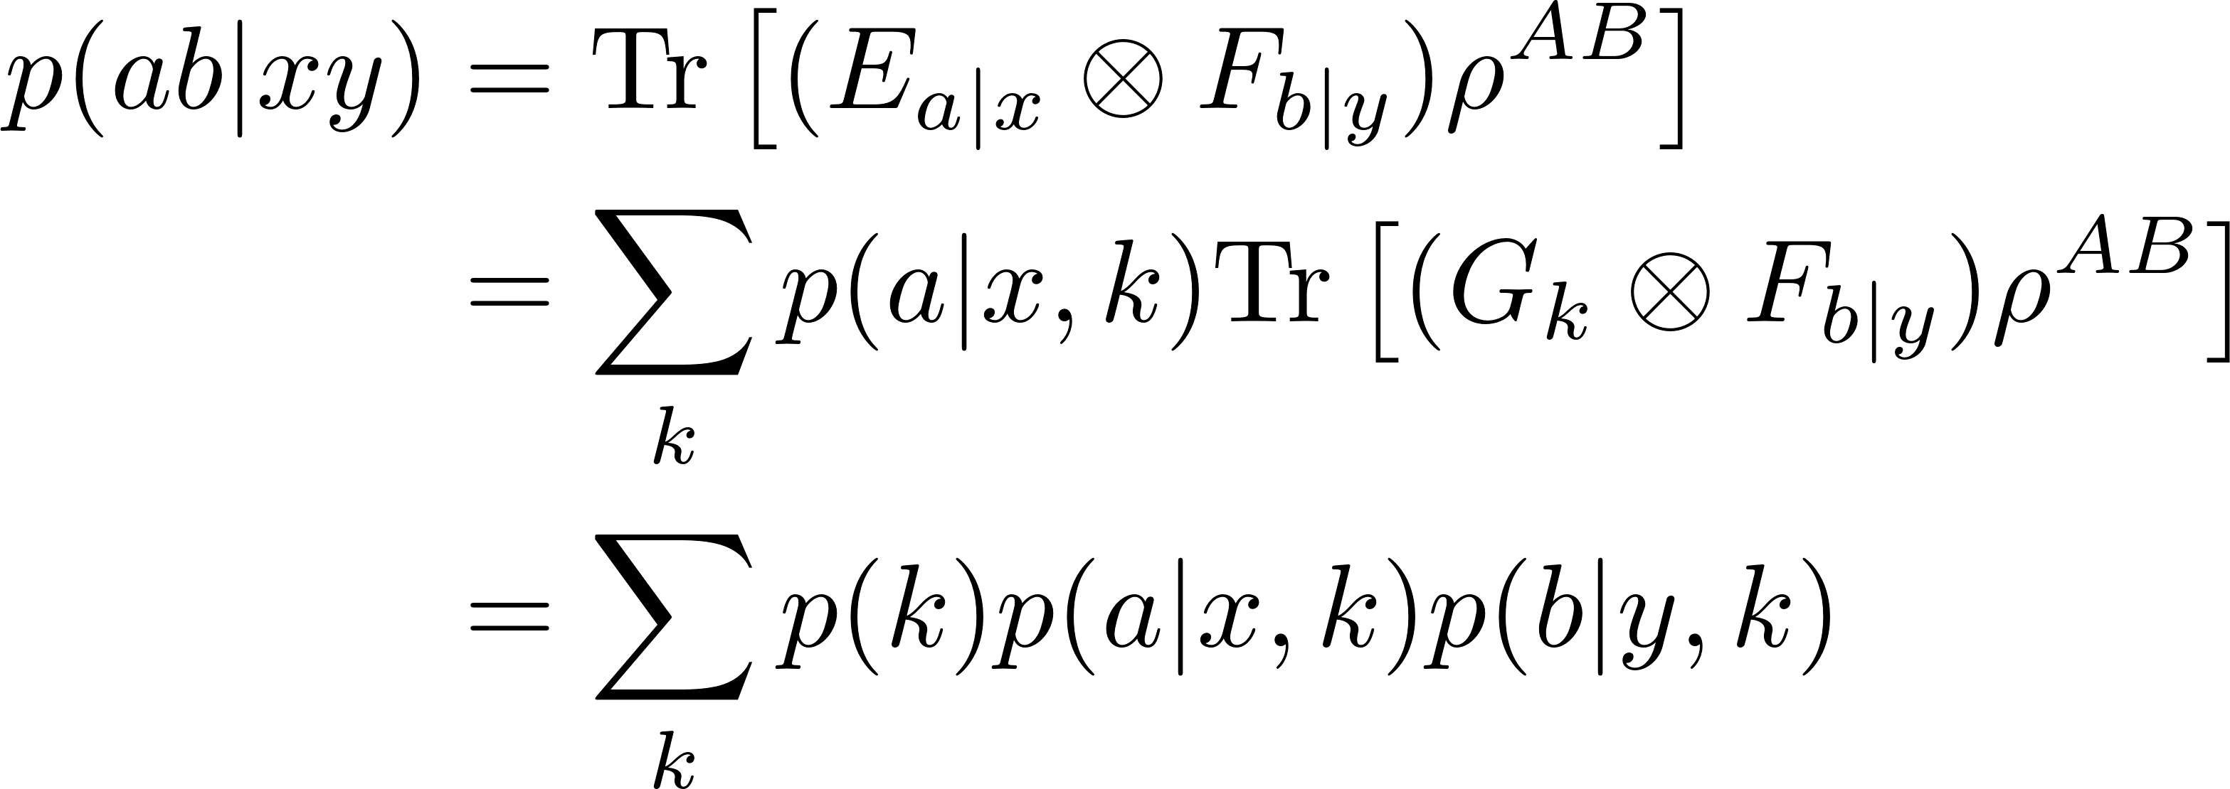
Measurement Incompatibility and Bell Nonlocality

Slide 14
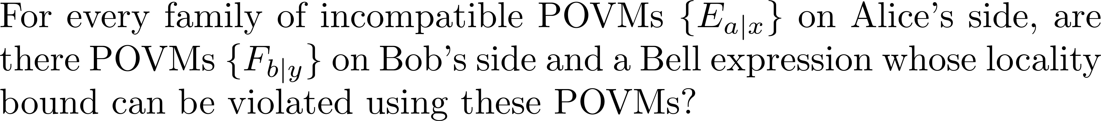

Measurement Incompatibility and Bell Nonlocality

Slide 15
Qubit Example of Measurement Incompatibility

Slide 16
Can we attain any other type of equivalence between Measurement Incompatibility and Nonlocality?
Measurement Incompatibility
Bell Nonlocality

Slide 17
Measurement Incompatibility and Nonlocality
Measurement Incompatibility
Bell Nonlocality
Entanglement
Bell Nonlocality

Slide 18


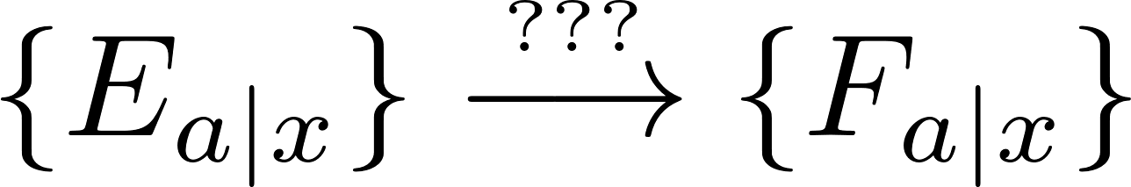
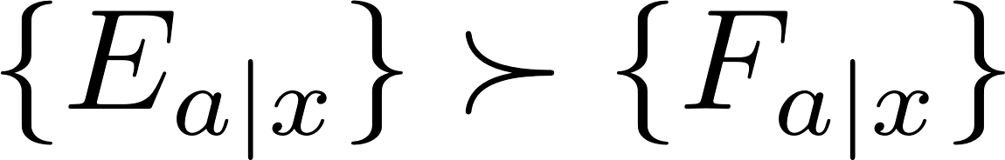
Semi-quantum Nonlocality
Entanglement
Semi-quantum Nonlocality
Measurement Incompatibility
Semi-quantum Nonlocality

Slide 19
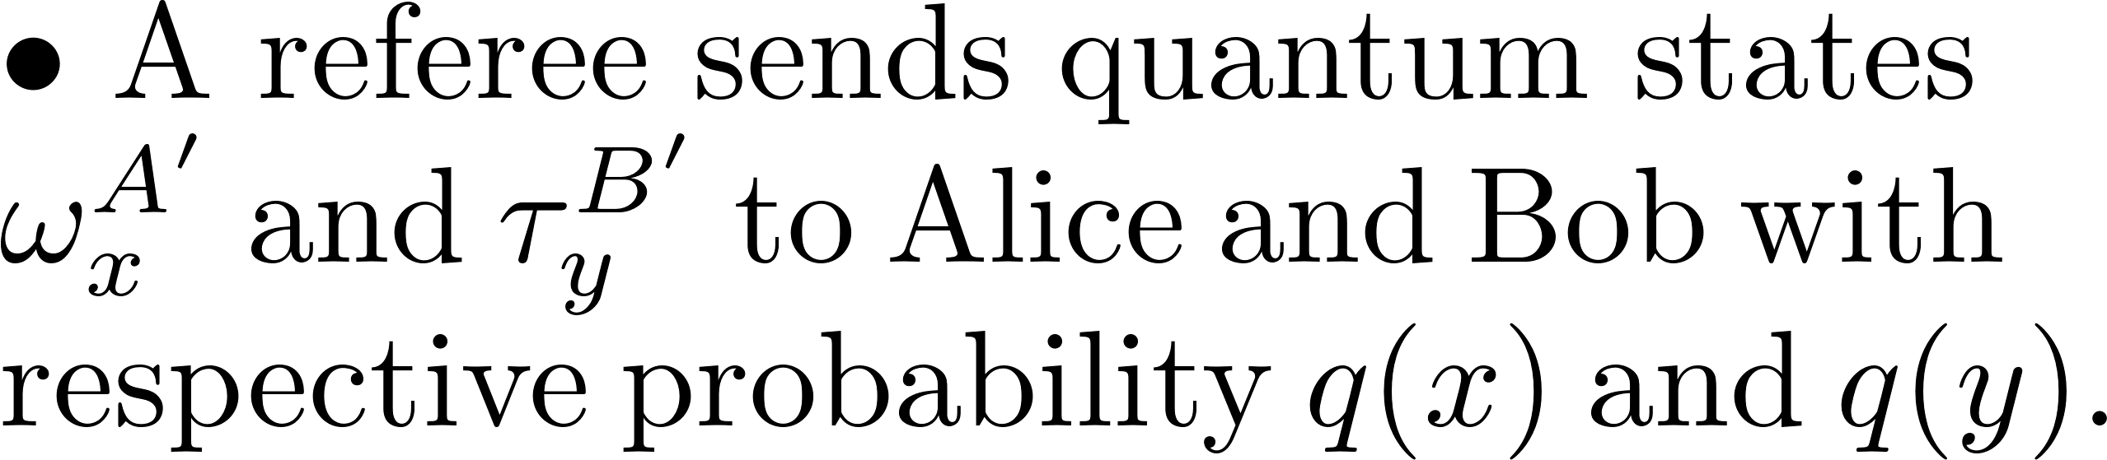

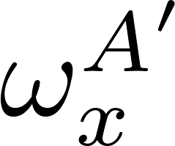

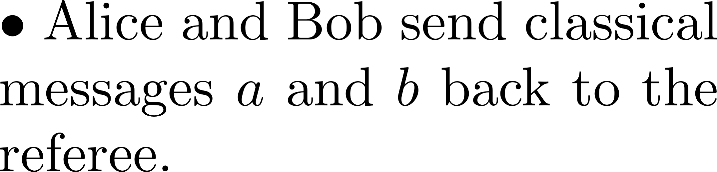
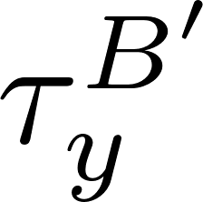
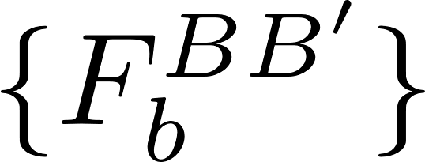
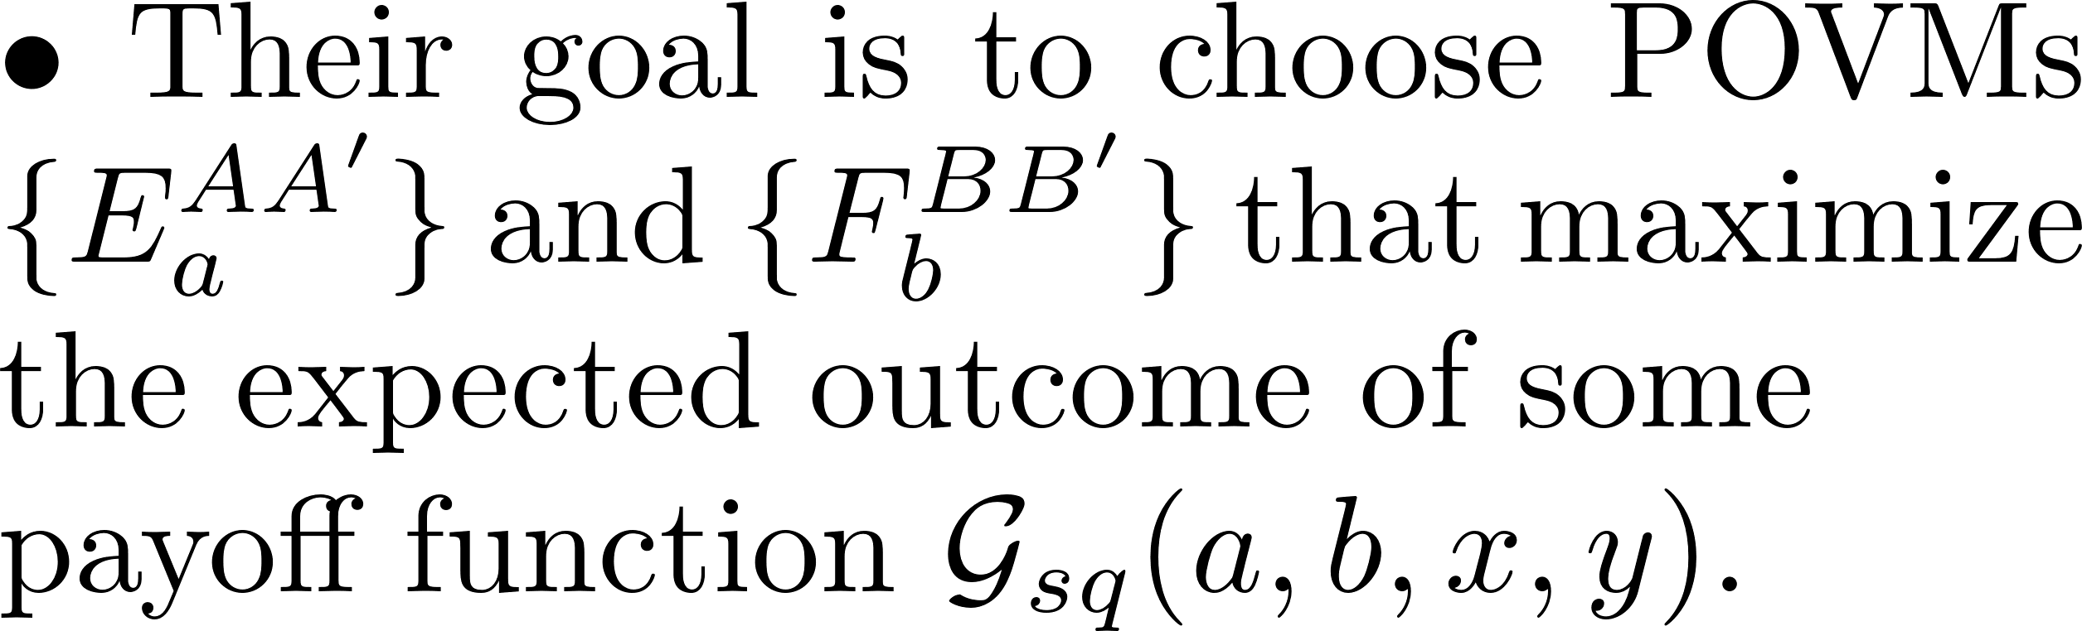
Semi-quantum Nonlocal Games (SqNG)

Slide 20

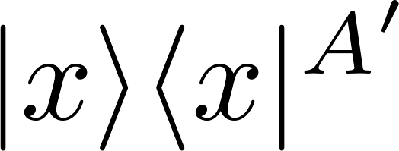
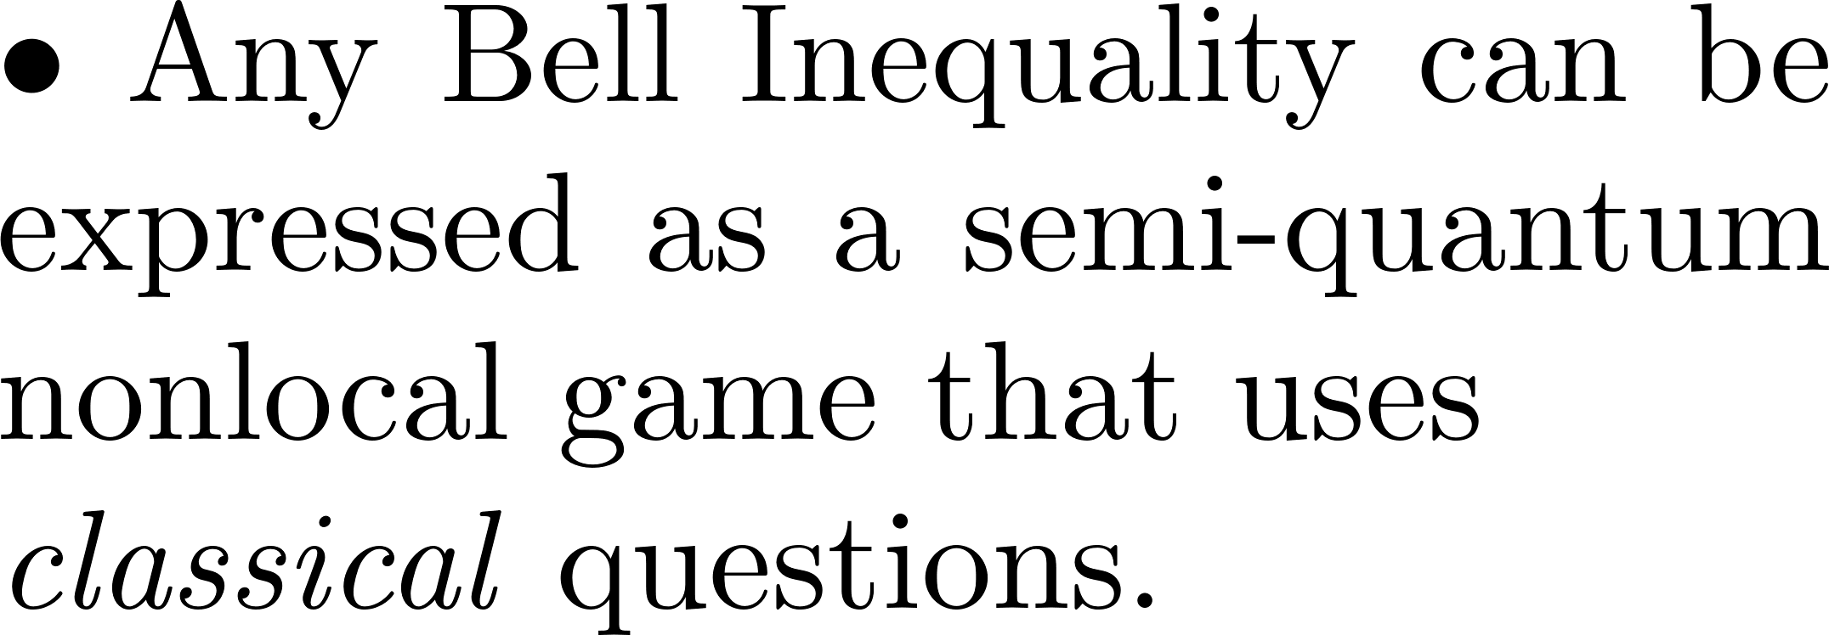
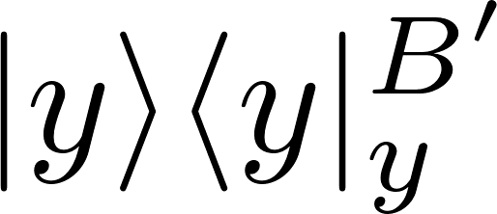
Semi-quantum Nonlocal Games (SqNG)

Slide 21

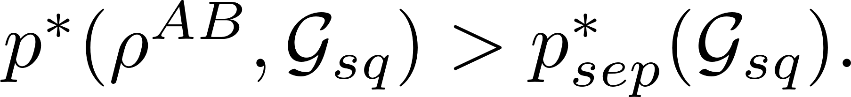
Semi-quantum Nonlocal Games (SqNG)

Slide 22
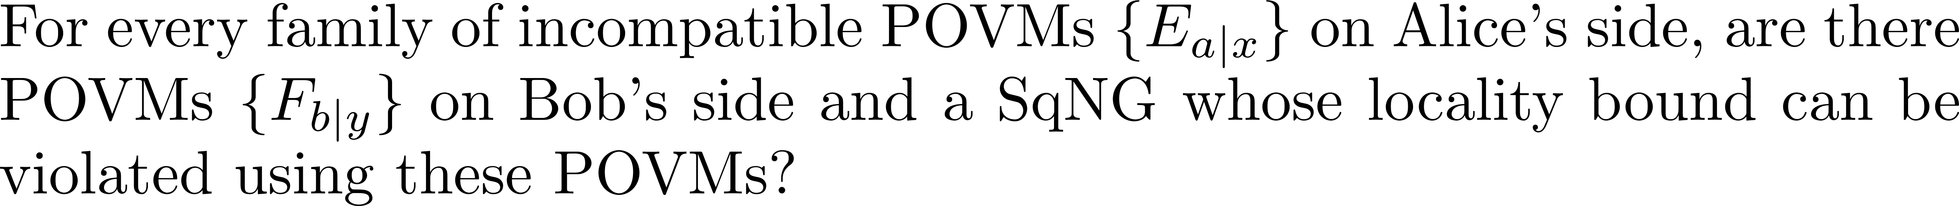
SqNG and Measurement Incompatibility

Slide 23
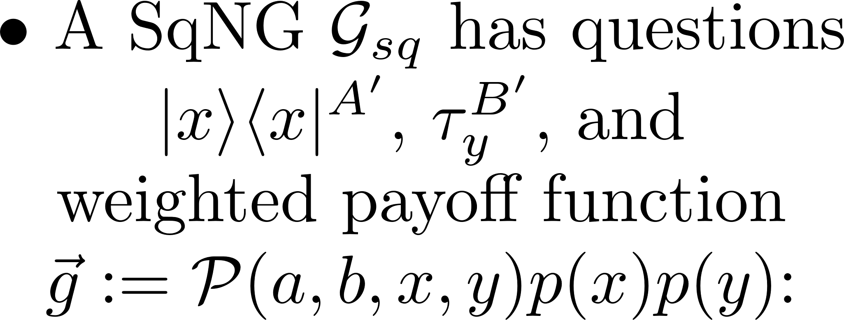




SqNG and Measurement Incompatibility

Slide 24



SqNG and Measurement Incompatibility

Slide 25

SqNG and Measurement Incompatibility

Slide 26







SqNG and Measurement Incompatibility

Slide 27





SqNG and Measurement Incompatibility

Slide 28

SqNG and Measurement Incompatibility

Slide 29



SqNG and Measurement Incompatibility
Compatible

Slide 30

SqNG and POVM Partial Ordering

Slide 31



SqNG and POVM Partial Ordering

Slide 32

SqNG and POVM Partial Ordering

Slide 33






Application: POVM Games

Slide 34


Application: Steering

Slide 35


Application: Steering

Slide 36
Relation to Clean POVMs

Slide 37
Conclusions
Bell Nonlocality
Entanglement
Measurement Incompatibility
Semi-quantum Nonlocality
Entanglement
Measurement Incompatibility

Slide 38

THANK YOU!

